Slide 1


Lending Club Dataset
Judah Drelich

Slide 2
Target Variable
Separate the features (X) from the target variable (y).
`loan_status`: supposed to be the target variable.
Too many of the features have information that was taken after the loans originated
`next_pymnt_d` records the date that the next loan payment is due
Shift the time of the question to the time that the dataset was taken.
Find the value of the remaining loans
Target variable is the fraction of the loan amount that the borrower will be able to pay back

Slide 3
Data Wrangling
All the features must have only numerical values
Some columns are numerical but need to be cleaned (Term: ‘ 36 months’)
Others are Categorical such as the type of employment that the borrower has.
Imputation of values for this dataset is the most challenging aspect of this project.
Assumed that the event didn’t happen if the data was missing and assigned values accordingly.
For counting variables such as the number of accounts, I filled in with a zero
For Months since an event happened, I filled in a large number so that it the models would act like it never happened.

Slide 4

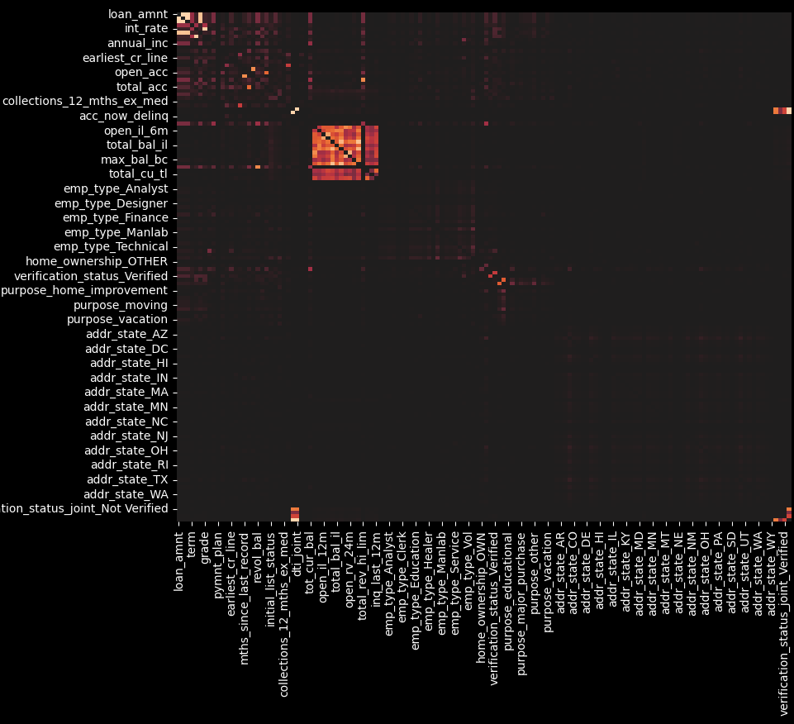
Data Wrangling
Multicollinearity
Initial heatmap for the correlations between the features

Slide 5
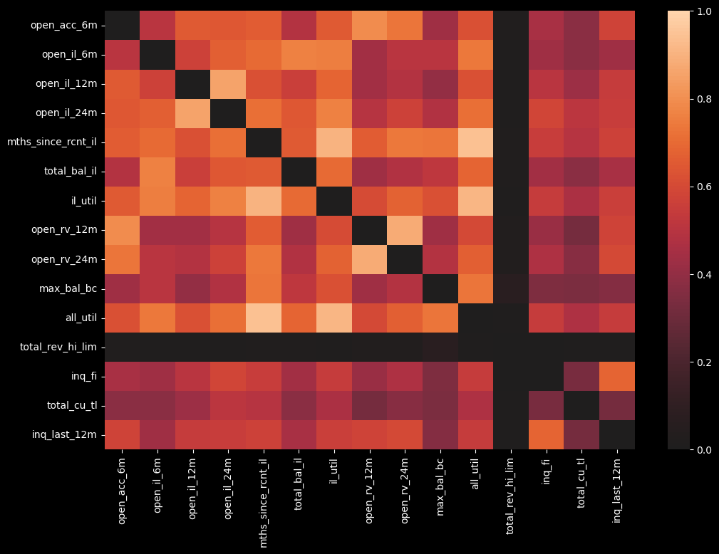
Data Wrangling
Multicollinearity
Focusing on the bright square of the previous heatmap
Notes:
Many of the features in this graph have tremendous overlap. For instance, `open_il_6m`, `open_il_12m`, `open_il_24m` are measuring the number of installment accounts in the last 6, 12, and 24 months that the borrower has opened. Instead of having to pick just one of these variables, I combined them all into an `open_il` variable by scaling the shorter and longer versions to match with the yearlong iteration and then averaged the three.
After combining as many variables as I could, I wrote code to find all the features that had correlations with each other above a given threshold. The criteria that I had for dropping features were the following:
Features that have default values of 0 are better than features with undefined values.
Dollar amounts are better than number of accounts. They give more information and with proper scaling are more useful.
The more information the variable contains, the better.
Synthesized features from multiple variables are better than original features.

Slide 6
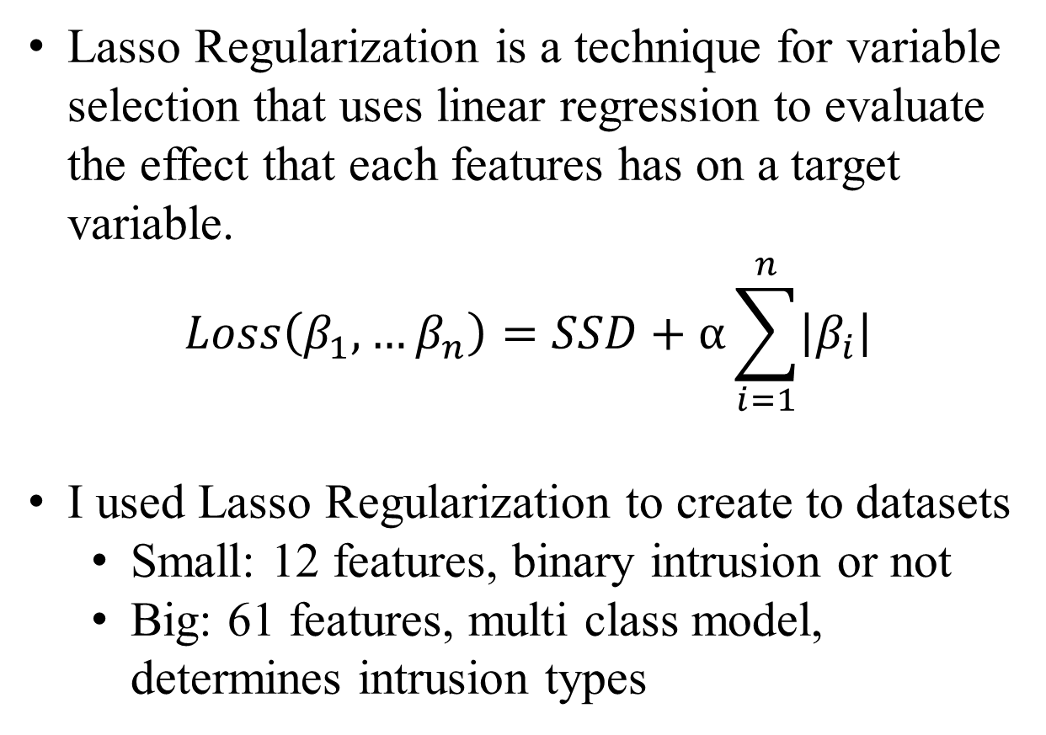
Data Wrangling
Lasso Regularization is a technique for variable selection that uses linear regression to evaluate the effect that each features has on a target variable.
$$Loss\left(β_{1},…β_{n}\right)=SSD+α\sum_{i=1}^{n}{\left|β_{i}\right|}$$
I used Lasso Regularization to create to datasets
Small: 12 features, binary intrusion or not
Big: 61 features, multi class model, determines intrusion types
Lasso Regularization
Feature Selection

Slide 7
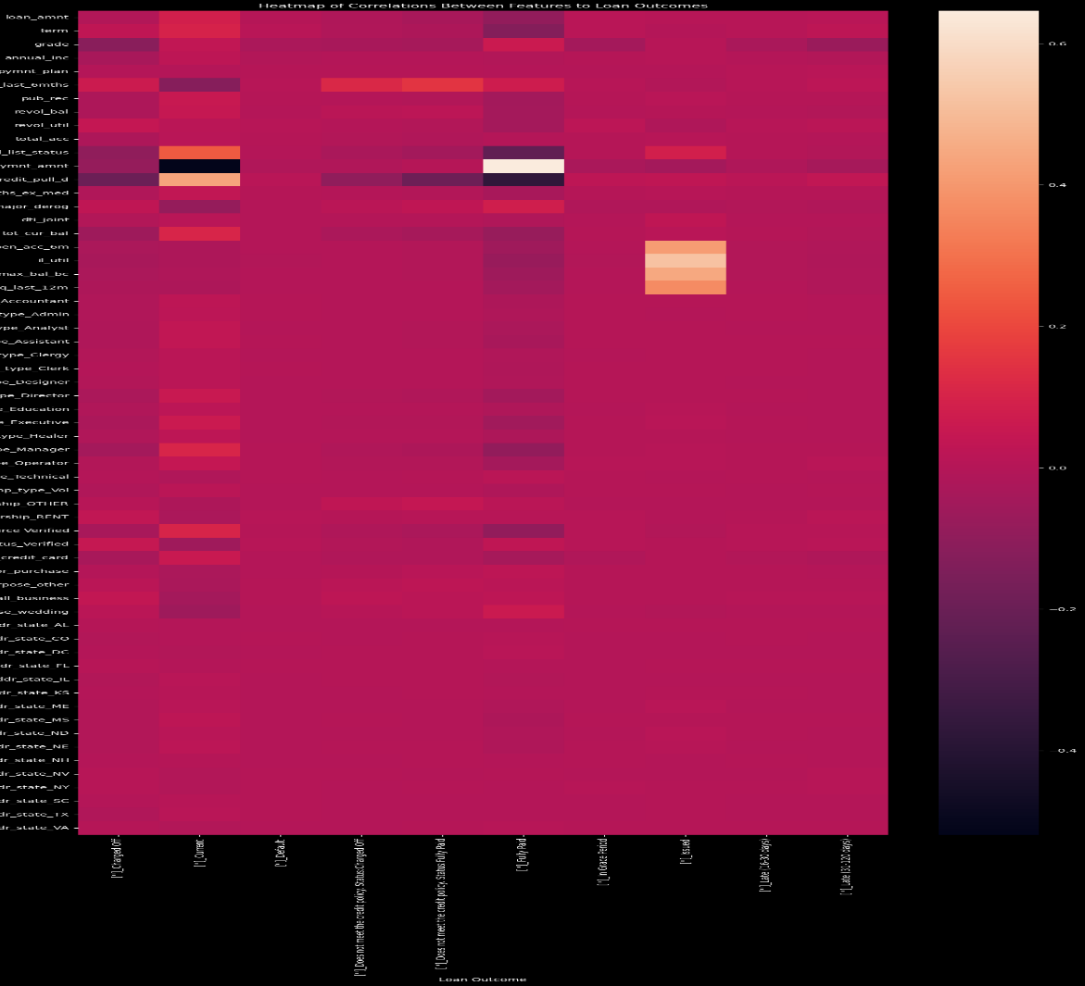
EDA Correlation Heatmap between features and loan statuses

Slide 8
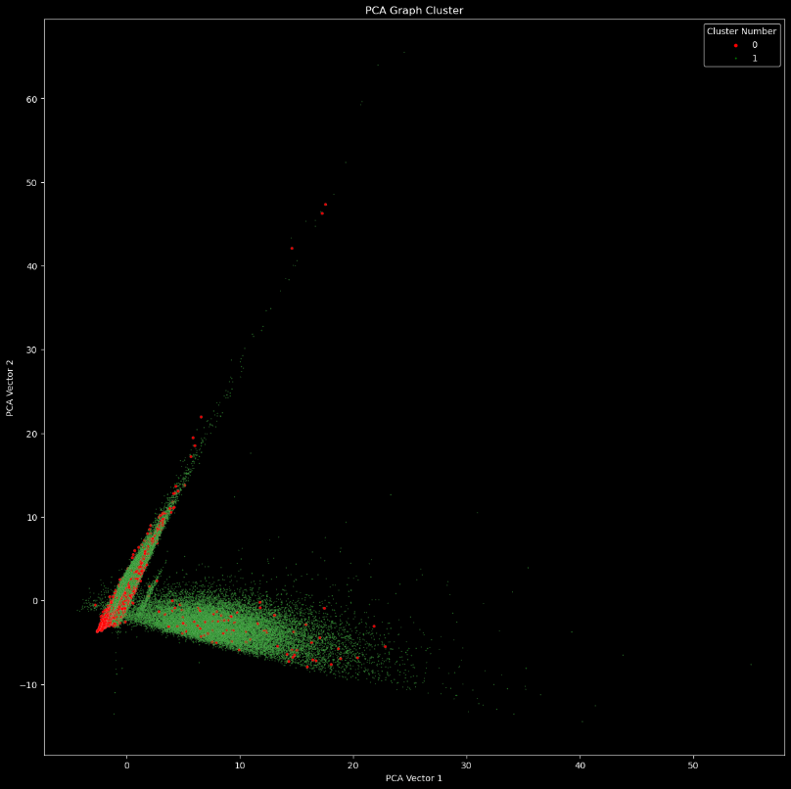
EDA PCA graph of the features with bad outcomes colored in red and good outcomes colored in green

Slide 9
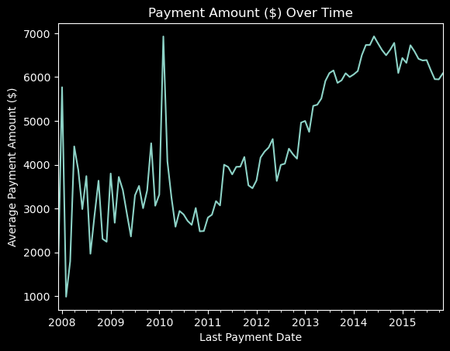
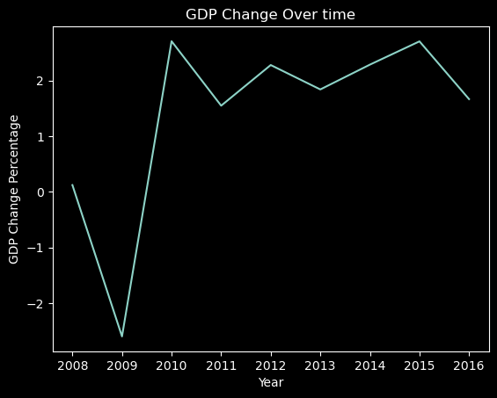
External Factors

Slide 10
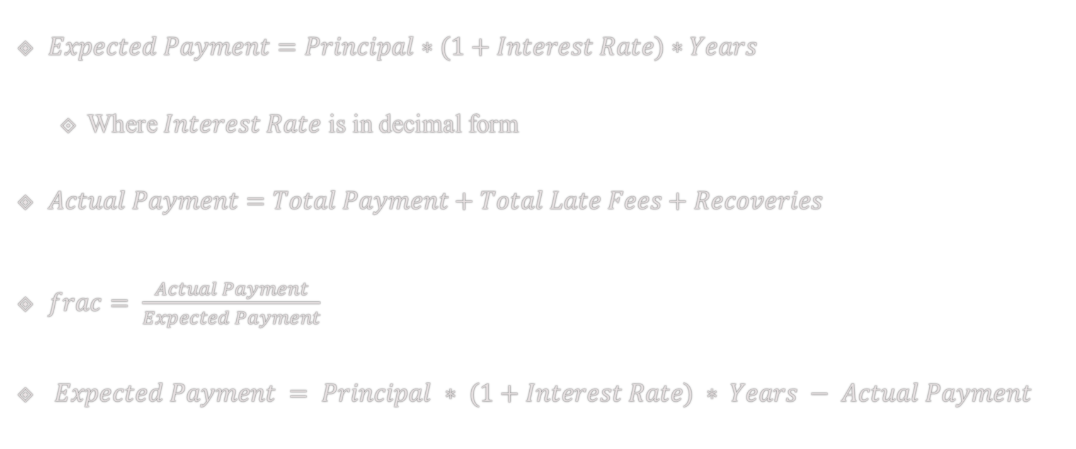
Preprocessing
$Expected Payment=Principal∗(1+Interest Rate)∗Years$
Where $Interest Rate$ is in decimal form
$Actual Payment=Total Payment+Total Late Fees+Recoveries$
$frac= \frac{Actual Payment}{Expected Payment}$
$Expected Payment = Principal ∗ (1+Interest Rate) ∗ Years − Actual Payment$

Slide 11
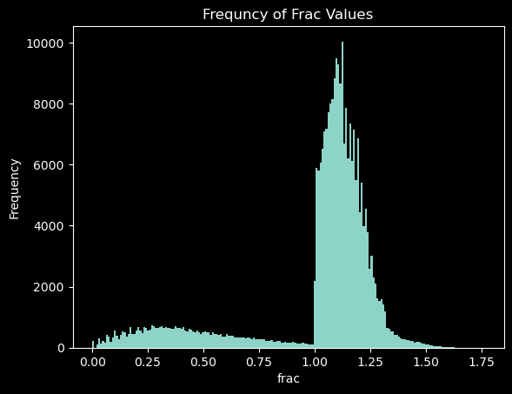
EDA - frac
Notes:
Below one, the values on the graph are skewed to the left. If the borrower does not pay off the loan, their credit rating will suffer. If a borrower is close enough to paying Lending Club back, the graph shows they will repay rather than damage their credit score.

Slide 12
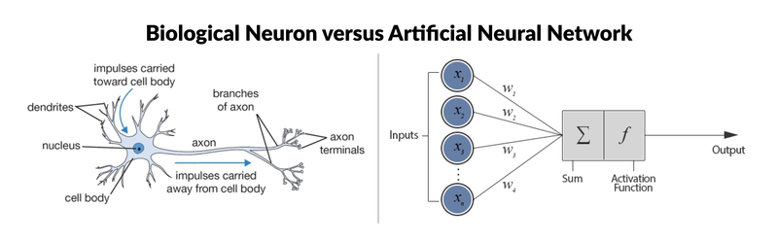
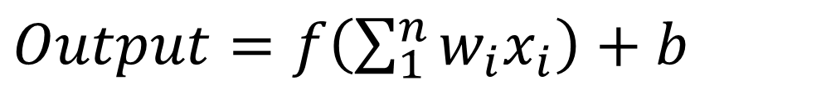
Modelling
Neural Networks
Diagram of the similarity between biological neuron and a node in a neural network
Formula for a node in a neural network
This Photo by Unknown Author is licensed under CC BY-SA
$Output=f\left(\sum_{1}^{n}{w_{i}x_{i}}\right)+b$
Notes:
The smaller neural net that I created has an input layer of 61, with 12 hidden layers of varying numbers of nodes and a final output layer of a single node. The activation function that I used for every layer except the last was Relu. The final layer does not have an activation function and outputs the sum of all the inputs from the previous layer.

Slide 13

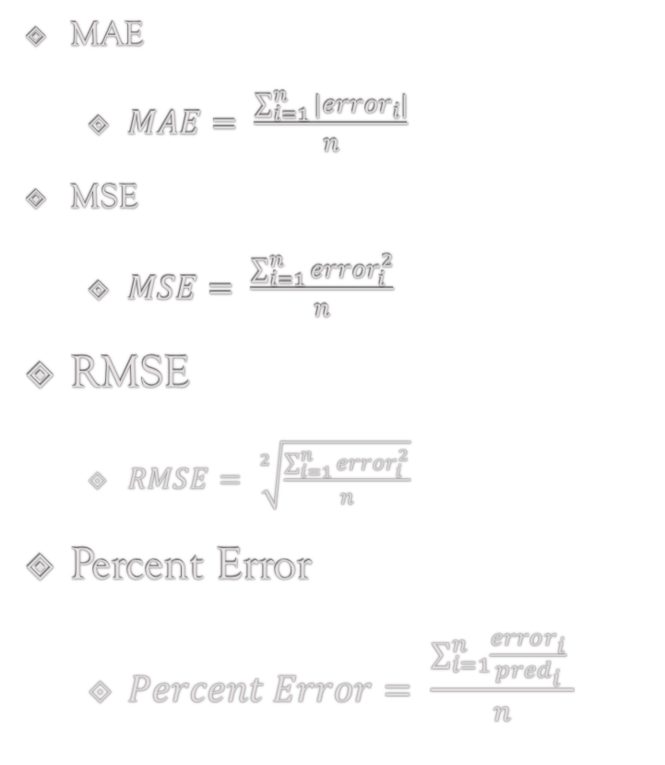
Metrics
MAE
$MAE= \frac{\sum_{i=1}^{n}{|{error}_{i}|}}{n}$
MSE
$MSE= \frac{\sum_{i=1}^{n}{{error}_{i}^{2}}}{n}$
RMSE
$RMSE= \sqrt[2]{\frac{\sum_{i=1}^{n}{{error}_{i}^{2}}}{n}}$
Percent Error
$Percent Error= \frac{\sum_{i=1}^{n}{\frac{{error}_{i}}{{pred}_{i}}} }{n}$

Slide 14
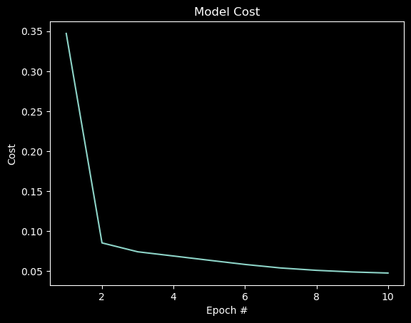
Training

Slide 15
Testing (Neural Network)
MSE = 0.0490,
RMSE = 0.2213,
MAE = 0.1386,
Mean Percent Error of 14.6275%.

Slide 16
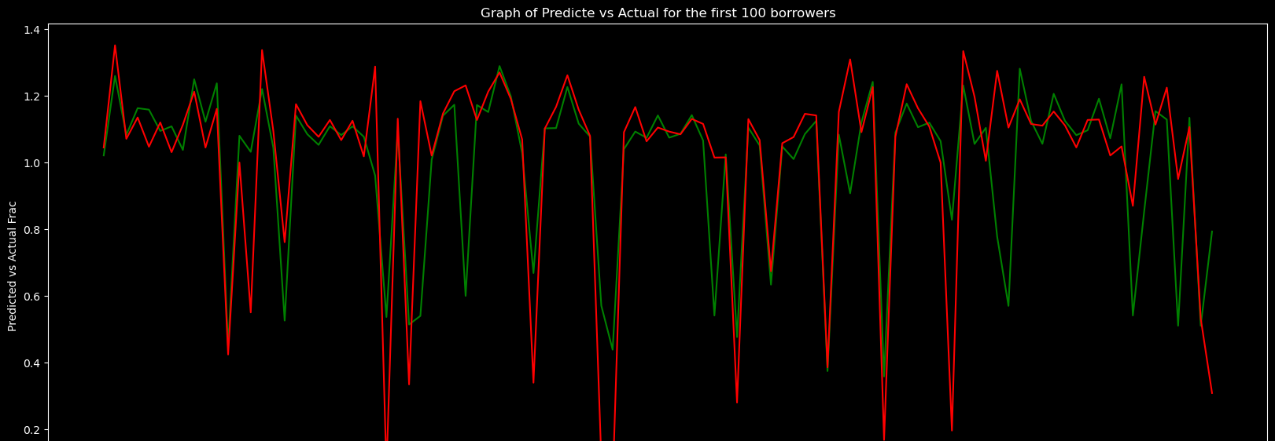

Testing NN cont.
Notes:
The graph below shows the first 100 loans with predictions in green and actual values in red.

Slide 17
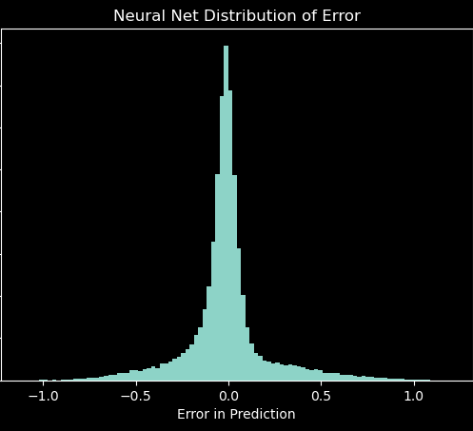
Testing NN cont.

Slide 18
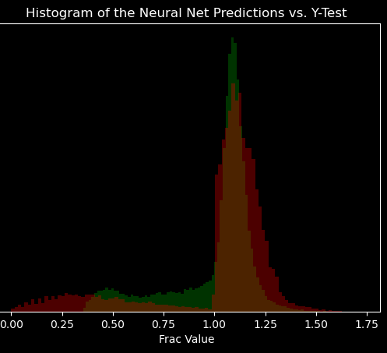
Testing NN cont.
Notes:
Interestingly, the model difficulty predicting loans that returned less than the expected investment. Given this outcome, it is useful to consider a second level of models that can transform the underperforming loans into the distribution of the actual loans.

Slide 19

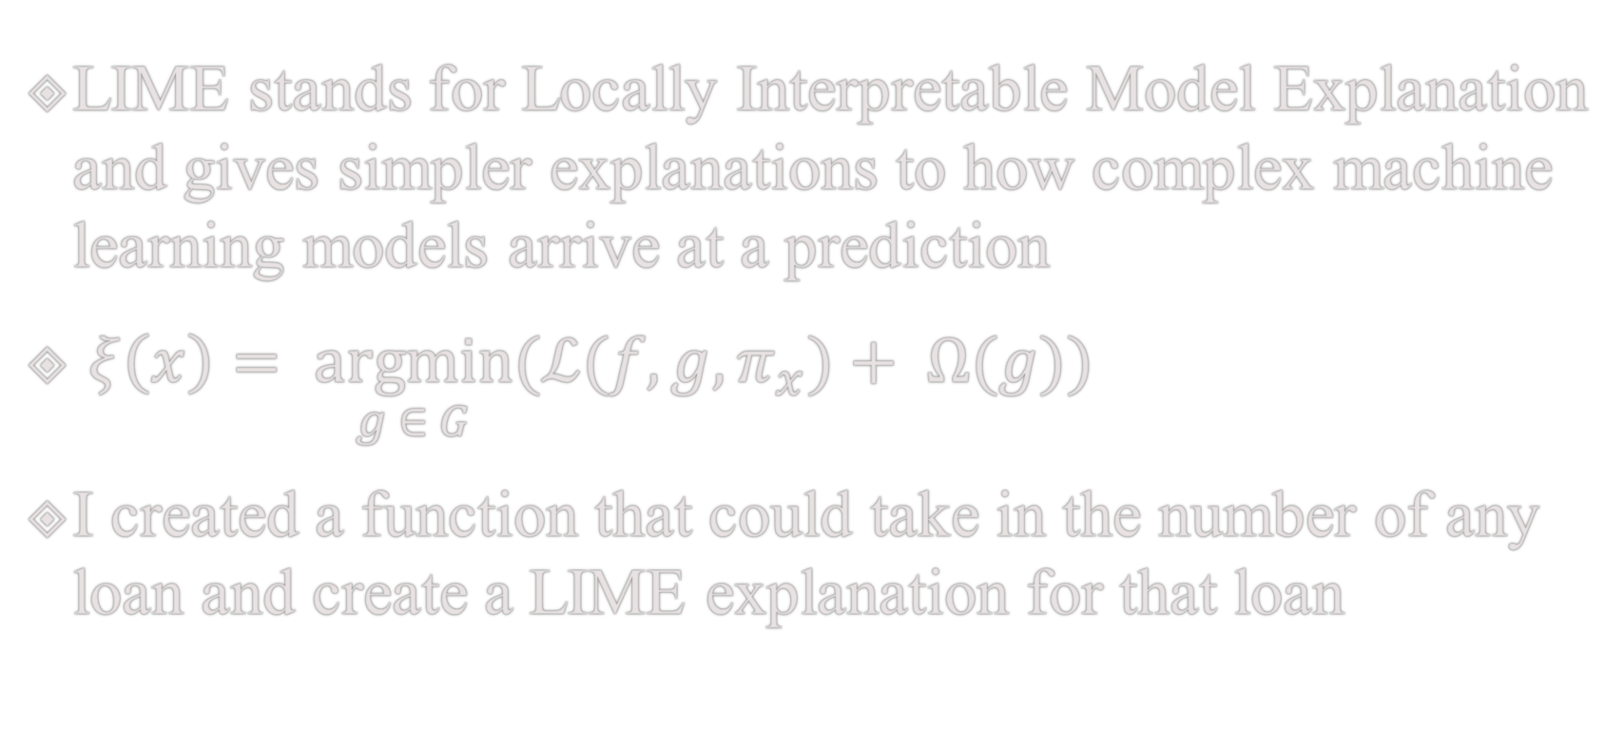
LIME
LIME stands for Locally Interpretable Model Explanation and gives simpler explanations to how complex machine learning models arrive at a prediction
$ξ\left(x\right)= \underset{g ∈ G}{argmin}{{(ℒ(f,g,π}_{x})+ Ω(g))}$
I created a function that could take in the number of any loan and create a LIME explanation for that loan

Slide 20
LIME cont.
Notes:
The white vs. blue parts represent a complex non-linear model, whereas LIME creates the simple dashed black line, which is much easier model to interpret. The observation in question is the bolded red plus sign that the model is trying to explain. When we examine close to the point of interest, a linear model is effective but as the model curves and turns it is no longer helpful.

Slide 21
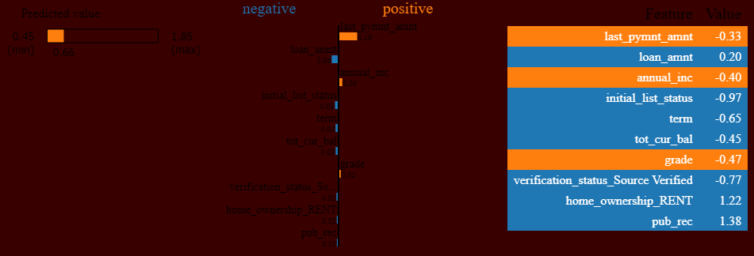
LIME cont.
Notes:
The predicted value on the left stems from the possible values that the inverse mapping function creates when transitioning from the binary vectors to numerical vectors. The graphical representation shows off the importance of the features from the ridge regression. Finally, the last column shows the actual values that were in the observation that underwent the LIME analysis. Since I scaled every value to allow the models to capture all the relationships between the variables, the values themselves do not mean as much. If an explanation were shown to an investor, I could use the original values of the loan instead of the processed scaled values that are devoid of real world meaning.

Slide 22
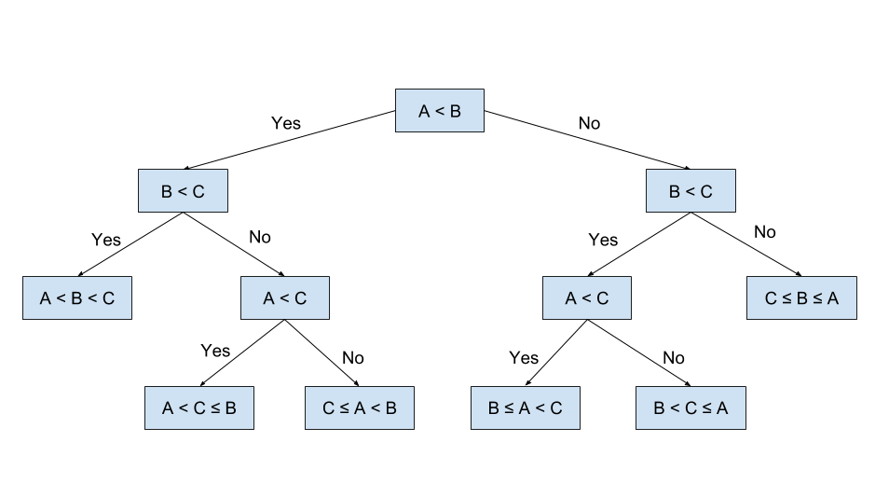
Modelling
Random Forest
Model of a single decision tree in a random forest
Purity measurement formula
This Photo by Unknown Author is licensed under CC BY
$Gini=1−\sum_{i=1}^{n}{{p_{i}}^{2}}$

Slide 23

Testing (Random Forest)
MSE = 0.0309,
RMSE = 0.1758,
MAE = 0.0872
Mean Percent Error of 13.6849%.

Slide 24
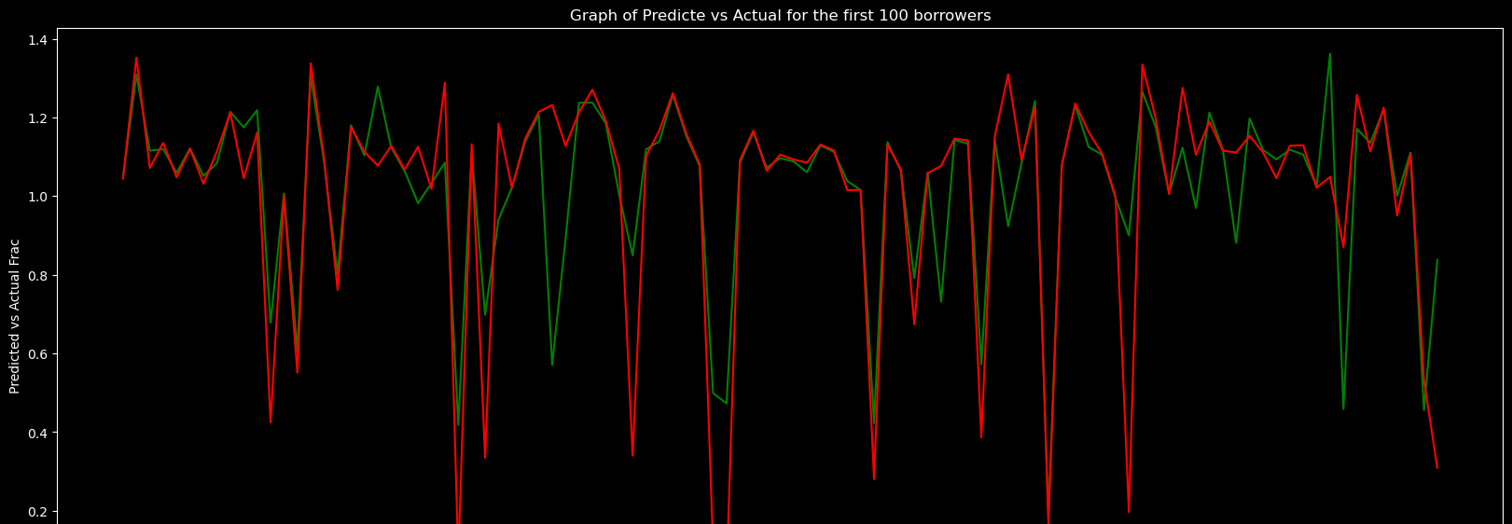
Testing (RF) cont.

Slide 25
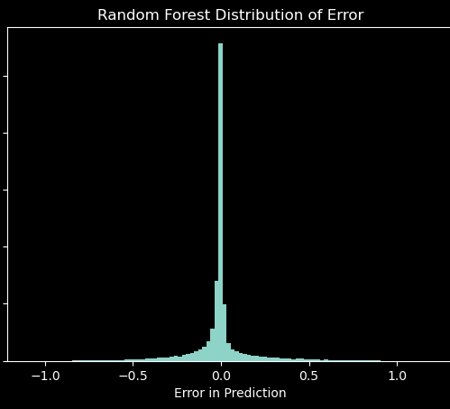
Testing (RF) cont.

Slide 26
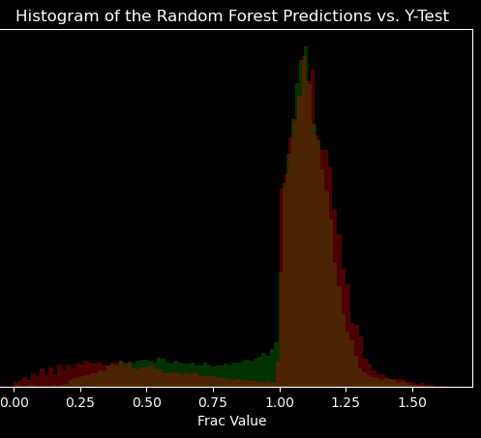
Testing (RF) cont.

Slide 27
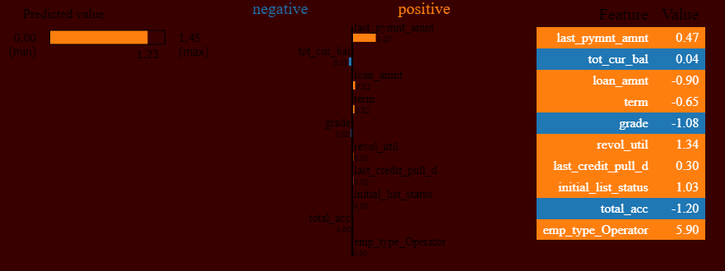
LIME (RF)

Slide 28
Conclusion
The most important methods from this paper are:
Random Forest Modelling
Locally Interpretable Modelling Explanation (LIME)
With most of the dataset comprised of current loans, it is impossible to evaluate the accuracy and precision of supervised learning methods.

